Slide 1
Analyzing the factors influencing Employee Attrition

Slide 2
Table of Contents
01
Introduction
02
Preparation
03
Analysis
04
Recommendation
Intro to the topic and the dataset
Data preprocessing for analysis
Exploratory data analysis
Draw conclusions and offer solutions

Slide 3
01
Introduction

Slide 4
The Problem
In a work environment, Employee Attrition describes an unanticipated attrition of the workforce. The causes of this decline are all unavoidable reasons such as retirement, resignation, employee loss of work capacity or sudden death. Companies with high workforce attrition rates often face the risk of abusing internal resources.

Slide 5
About the Dataset
This is a fictional dataset created by IBM data scientists. Includes more than 35 attributes, it provides a comprehensive and diverse analysis of an organization's employees, focusing on areas such as employee attrition, personal and work-related factors, and resources.

Slide 6
02
Preparation

Slide 7

1) Import data
2) Remove unnecessary columns

Slide 8

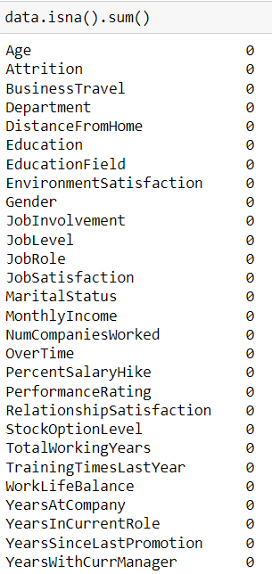
3) Check for duplicate and missing values

Slide 9
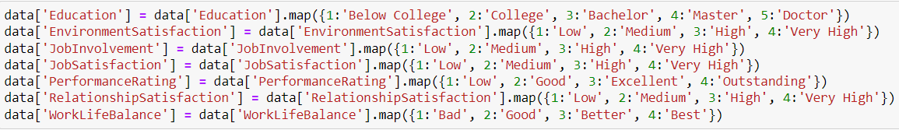
4) Replace values
5) Export data

Slide 10
03
Analysis

Slide 11
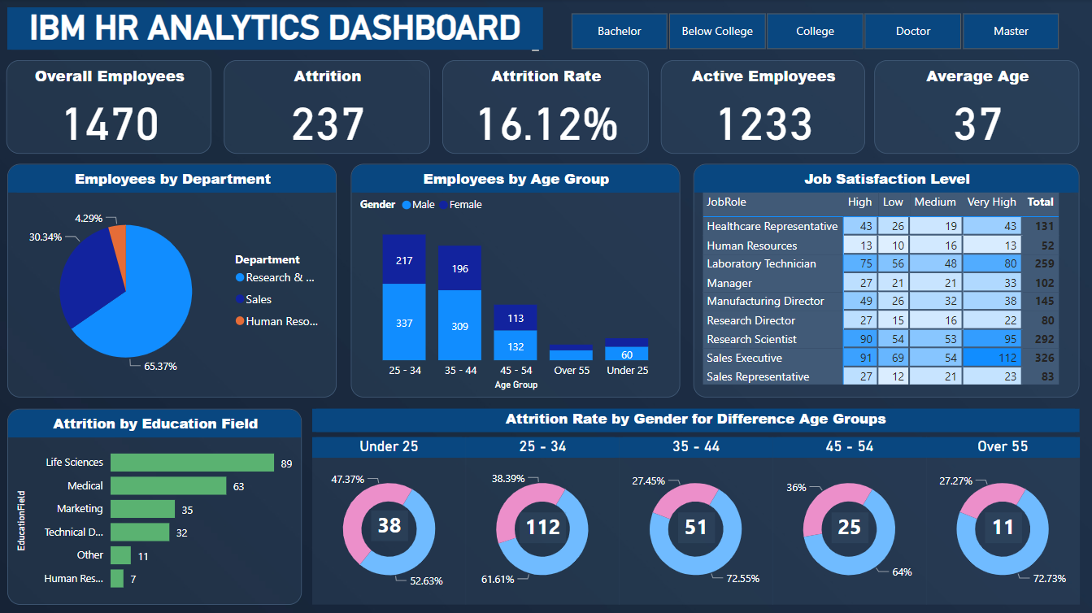

Slide 12
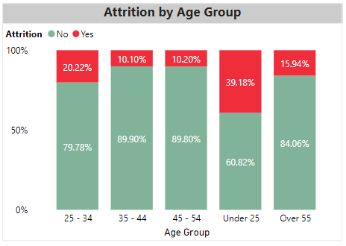
How is attrition dependent on different age groups?
Employees under the age of 25 have the highest quit rate, followed by those between the ages of 25 and 34. As age increases, employees tend to be more engaged.

Slide 13
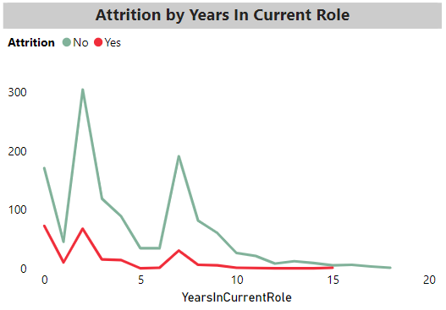
How does work duration in current role impact attrition?
People are more prone to leave the organization in the starting years on their role. When people are in the same role for a long period of time, they tend to stay longer for moving in an upward role.

Slide 14
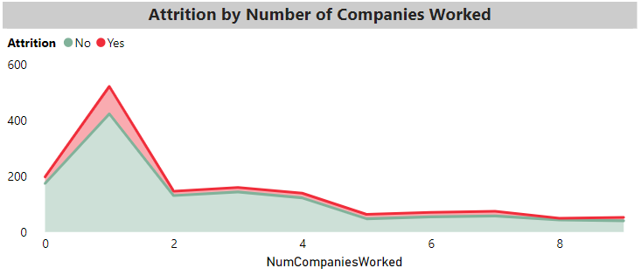
How does work experience affect attrition?
Employees who started their career with the company, have a higher chances of leaving the organization to a different company. People who have gained much experience, working in multiple companies tend to stay in the company they join.

Slide 15
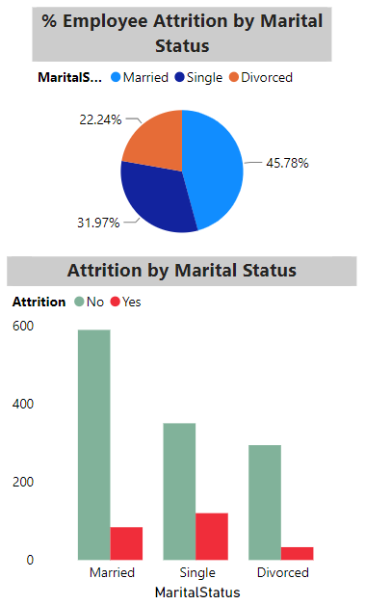
Is marital status related to the decision to quit or not?
Single employees has the highest turnover rate. This can be seen that young and free people (not having to worry about family) tend to jump work to experience many different working environments and find jobs that match their interests.

Slide 16
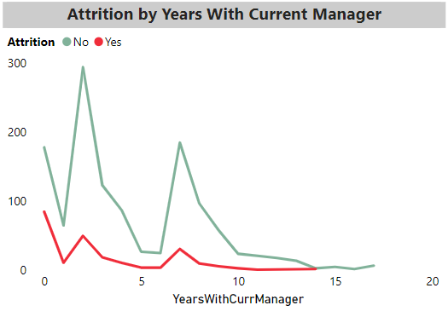
Are managers a reason for people resigning?
People frequently quit their job at the beginning, when their time with their manager is relatively short, taking into account their relationship with past supervisors. When employees believe they need improvement, they often look for a change after two years. People frequently seek a change when they have worked with a manager for a period of time that is significantly longer. However, individuals are happy with their work when they spend a lot of time with their management. As a result, the likelihood of an employee quitting is quite low.

Slide 17
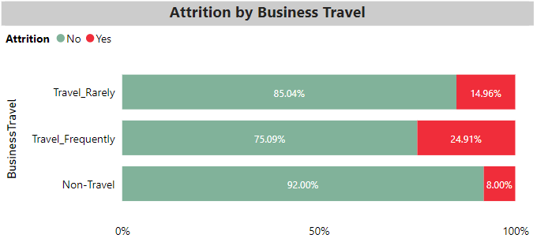
How do business trips affect an employee's decision to quit?
Highest employee attrition can be observed by those employees who travels frequently and for employees who do not have to travel for work, they are less likely to give up their current job.

Slide 18
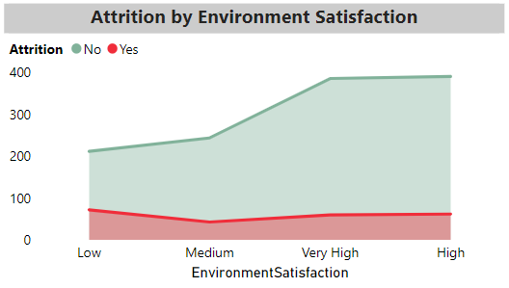
How does the environment satisfaction impact attrition?
When the satisfaction level is low and medium, the chances of people leaving the organization slightly decreases. This is indicative of the better hopes with which people stay in an organization.

Slide 19
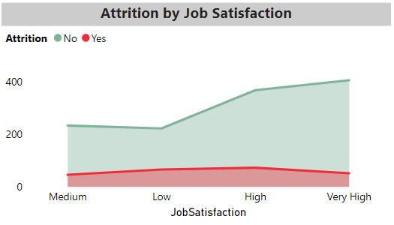
How does self job satisfaction impact attrition?
With an increasing job satisfaction, the attrition rates decrease, except for employees with a high level of satisfaction, they tend to quit more.

Slide 20
04
Recommendation

Slide 21
Solutions
The below recommendations is based on the key findings related to reducing attrition rate.
Implement strategies to address the specific needs and career aspirations of employees across different age groups.
Regularly review and benchmark compensation packages to ensure they are competitive in the market.
Provide opportunities for career advancement, skill development, and cross-functional training.
Enhance employee engagement and job satisfaction by offering a supportive work environment.
Focus on improving factors such as environment satisfaction, job involvement, job satisfaction, work-life balance, and managing overtime demands.

Slide 22
THANK YOU FOR YOUR ATTENTION

